Slide 1
Overview of Partnership Funding Opportunities October, 2015

Slide 2
Agenda
Partnership Grants (PG) & Partnership Development Grants (PDG)
Key Characteristics
Competition Cycle
Special Initiatives
Frequently Asked Questions
Questions from the audience

Slide 3
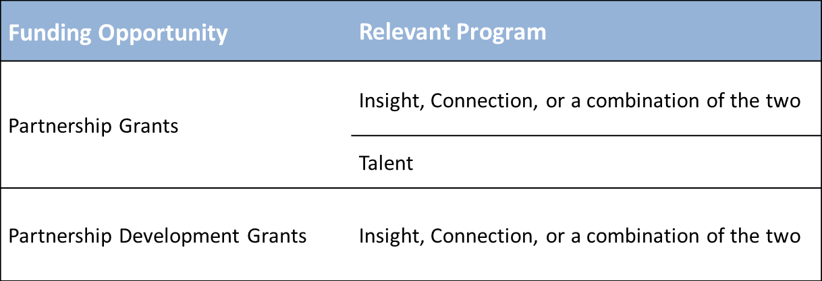
Key Characteristics

Slide 4
Key Characteristics
Partnership Grants
Partnership Development Grants
Institution is the applicant
Duration of 4 to 7 years
Valued up to $2.5M
Minimum 35% cash and in-kind contribution required from other sources (i.e., institution and partners)
Two-stage application process
PG LOI deadline is February 15
Project Director is the applicant
Duration of 1 to 3 years
Valued between $75K and $200K
No minimum contribution required from other sources
One-stage application process
PDG deadline is November 30

Slide 5
Key Characteristics
Administering organization can be a Canadian university, college or non-profit organization.
Requires a formal partnership.
Partnerships may be academic-only or multisectoral.
At least one post-secondary institution must be involved.

Slide 6
Key Characteristics
Individuals: the project director, co-applicants or collaborators.
Organizations: the applicant (PG-only) and as partners or supporting organizations.

Slide 7
Key Characteristics
Partnership Approaches:
Disciplinary and interdisciplinary research partnerships
Cross-sector co-creation of knowledge and understanding
Networks for research and/or related activities
Partnered knowledge mobilization
PG Only: Partnered research centres; Partnered Chairs; Partnered Research Training Initiatives

Slide 8
Key Characteristics
Multidisciplinary selection committees include expertise from the academic community, and from the public, private and non-profit sectors.
Evaluation criteria include Challenge, Feasibility, and Capability.
Partnership toolkit designed to assist researchers and partners at various stages.

Slide 9
Key Characteristics
Tools for Research and Related Activities:
SSHRC defines research and related tools as vehicles that broadly facilitate research and related activities.
SSH tools enable researchers to collect, organize, analyze, visualize, mobilize and store quantitative and qualitative data and creative outputs.
In PG, between $7K and $500K can be requested for tools.
In PDG, a maximum of $7K can be requested for tools.

Slide 10
Key Characteristics
Research-creation proposals are eligible, and involve a slightly modified application form.
Salary Research Allowances are available for Canadian not-for-profit organizations with a project director or co-applicant on the proposal.

Slide 11
Competition Cycle
Internal eligibility review conducted;
Selection Committee(s) are formed; and
Proposals are evaluated
August: Application available
March: Results announced
November 30th: Application Deadline
Partnership
Development
Grants
September: Application available
Spring: Results announced
February 15th: Application Deadline
Partnership
Grants
(LOI)
July: Application available
Spring: Results announced
November 1st : Application Deadline
Partnership
Grants
(Formal)

Slide 12
Special Initiatives
Some special initiatives that are offered through PG and PDG include the Kanishka Project, the Belmont Forum, and the Mitacs-Accelerate Internship program.
There are some special initiatives/approaches that are only offered through PG:
Partnered Research Training Initiatives
CFI’s John R. Evans Leaders Fund.

Slide 13
Special Initiatives: HPW
Healthy and Productive Work reflects the interplay between health and social sciences in responding to the growing interest in maintaining a healthy, productive and inclusive Canadian workforce
Collaboration between:
OBJECTIVE: To develop evidence-informed and gender-responsive solutions to foster the labour force participation of men and women with health issues and disabilities, as well as older workers and workers with caregiving responsibilities outside of their paid work.

Slide 14
Special Initiatives: HPW
Phase I
Partner leverage not required
Phase 2
Partner leverage (cash and/or in-kind) required
Partnership
Grants
(2017 launch)
Partnership Development Grant
Deadline: November 30th, 2015

Slide 15
Special Initiatives: HPW
Stage 1: PDG | Stage 2: PG
Individual Grant (Applicant) | Institutional Grant (Project Director)
2 Years | 5 years
$75,000/year | $325,000/years 1-4 $125,000/year 5 for dissemination
No mandatory matching funds | Minimum of 35% matching funds over the 5 year grant period
Developing Formal Partnership | Established Formal Partnership
Greater Emphasis on the Challenge: The IDEA | Greater Emphasis on the Feasibility: The GOVERNANCE

Slide 16
Special Initiatives
In May 2015, SSHRC launched new initiatives to support and promote Aboriginal research and talent development.
Aboriginal research statement of principles will serve to guide the implementation of SSHRC’s current and future activities.
A revised definition of Aboriginal research clarifies research “by and with” Aboriginal Peoples and emphasizes and values the existing strengths, assets and knowledge systems of Aboriginal Peoples and communities.
Guidelines for the Merit Review of Aboriginal Research are intended to assist committee members in interpreting SSHRC’s specific Challenge, Feasibility and Capability evaluation criteria in the context of Aboriginal research.

Slide 17
Special Initiatives
Economic Action Plan 2013 proposed additional funding of $7 million per year for partnerships between industry and academic researchers.
Industry partner: A for-profit organization, or an organization that assists, supports, connects and/or represents the common interests of a group of for-profit, incorporated organizations, such as an industry association or a formal or informal consortium.

Slide 18
Special Initiatives
Imagining Canada’s Future: Six Future Challenge Areas
New ways of learning for an evolving society and labour market;
Effects of the quest for energy and natural resources;
Experiences and aspirations of Aboriginal peoples in Canada;
Leveraging emerging technologies;
Implications of global peak population; and
Knowledge for an interconnected, evolving global landscape.

Slide 19
Special Initiatives
Societal Implications of Disruptive Innovation in Genomics
Joint agreement between SSHRC and Genome Canada (GC) to promote social sciences and humanities research and related activities aimed at expanding understanding of the potential for new and emerging genomic innovations to profoundly affect society
Initiative focuses on understanding the societal implications of genomic innovations characterized as “disruptive”
Offered within several of SSHRC’s funding opportunities
Applications will be assessed against all other proposals received under a given SSHRC funding opportunity; GC will do a review of relevant proposals recommended for funding

Slide 20
Frequently Asked Questions
When should the host institution be invited as a partner? (PDG only)
What is required from co-applicants? What is required from partner organizations?
What has to be submitted as evidence of the formal partnership?
Is an intra-university partnership eligible on its own?

Slide 21
Frequently Asked Questions
Is the time that a participant plans to dedicate to the project an eligible in-kind contribution?
Can SSHRC funds be requested for internationally-based participants, students and/or other personnel?
Are applicants required to use Times New Roman 12pt font in the charts, tables and/or diagrams that are included within their application?
Can a participant receive a salary from the grant?

Slide 22
Frequently Asked Questions
Can SSHRC funds be requested for the costs of a project coordinator and/or manager?
If I’m applying from a non-profit organization, do I have to obtain institutional eligibility from SSHRC before applying?
If I applied for an Insight Grant, Insight Development Grant, or a Connection Grant, can I apply for a PG or PDG?

Slide 23
Any Other Questions?
Program Support: partnershipgrants@sshrc-crsh.gc.ca
Technical Support: webgrant@sshrc-crsh.gc.ca

Slide 24
Thank you!

